Slide 1
4:19-5:5

Slide 2
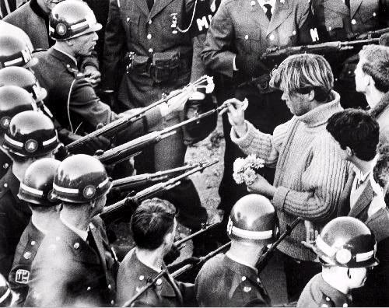
4:19-5:5

Slide 3
4:19-5:5

Slide 4
4:19-5:5
Phil. 1:9 ~ And this I pray, that your love may abound still more and more in knowledge and all discernment,
Eph. 4:15 ~ … speaking the truth in love …
Ps. 141:5 ~ Let the righteous strike me; It shall be a kindness. And let him rebuke me; It shall be as excellent oil; Let my head not refuse it. For still my prayer is against the deeds of the wicked.

Slide 5
4:19-5:5

Slide 6
4:19-5:5
1 Thess. 4:9 ~ But concerning brotherly love you have no need that I should write to you, for you yourselves are taught by God to love one another;
Brotherly love ~ philadelphia
Love ~ agapaō
1 Pet. 1:22 ~ Since you have in obedience to the truth purified your souls for a sincere love of the brethren, fervently love one another from the heart,
1st love ~ philadelphia
2nd love ~ agapaō

Slide 7
4:19-5:5
Rom. 12:18 ~ If it is possible, as much as depends on you, live peaceably with all men.

Slide 8
4:19-5:5

Slide 9
4:19-5:5
Ps. 133:1-3 ~ ¹ Behold, how good and how pleasant it is
For brethren to dwell together in unity!
² It is like the precious oil upon the head,
Running down on the beard,
The beard of Aaron,
Running down on the edge of his garments.
³ It is like the dew of Hermon,
Descending upon the mountains of Zion;
For there the LORD commanded the blessing —
Life forevermore.

Slide 10
4:19-5:5

Slide 11
4:19-5:5
Chapter 1 ~ fellowship
Chapter 2 ~ knowledge
Chapter 3 ~ abiding
Chapter 4 ~ selflessness (agapaō)
Chapter 5 ~ faith

Slide 12
4:19-5:5
Faith ~ n. pistis; v. piteuō (usually translated believe)
To put faith in, rely on, have confidence in
Synonyms ~ faith, believe (belief), trust
½ of the occurrences of pistis and pisteuō in New Testament occur in John's writings

Slide 13
4:19-5:5

Slide 14
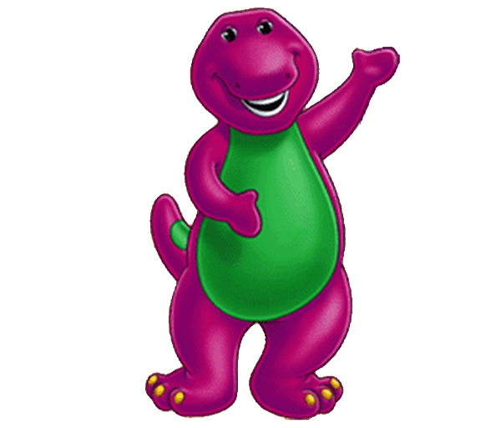
4:19-5:5
2:3 ~ Now by this we know that we know Him, if we keep His commandments.
2:29 ~ If you know that He is righteous, you know that everyone who practices righteousness is born of Him.
3:14 ~ We know that we have passed from death to life, because we love the brethren.
4:7 ~ Beloved, let us love one another, for love is of God; and everyone who loves is born of God and knows God.
4:12 ~ By this we know that we abide in Him, and He in us, because He has given us of His Spirit.

Slide 15
4:19-5:5

Slide 16
4:19-5:5
Ps. 119 ~ I delight … (7x in KJV)

Slide 17
4:19-5:5

Slide 18
4:19-5:5
Overcomes ~ nikaō – to be victorious
Rom. 8:37 ~ Yet in all these things we are more than conquerors through Him who loved us.
More than conquerors ~ hupernikaō

Slide 19
4:19-5:5

